Slide 1
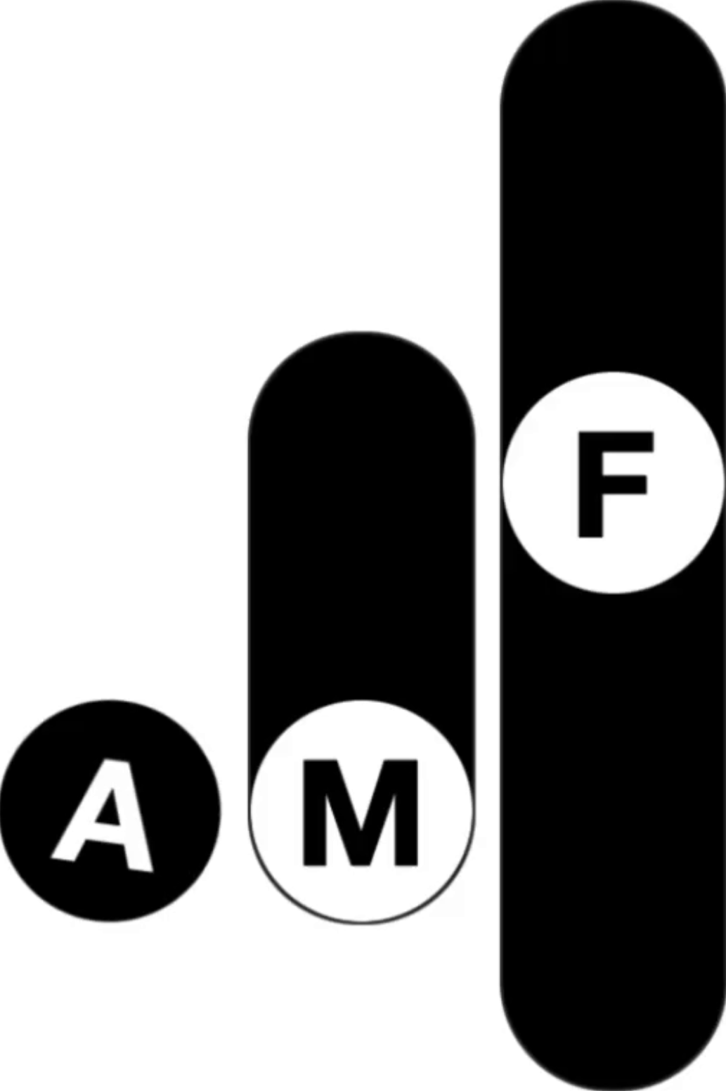
ALL MY FRIENDS
A next generation music management team.
We treat our artists like partners, not product.

Slide 2
01 - WHO WE ARE
THE EVOLVED MANAGEMENT COMPANY
All My Friends Inc. is a bootstrapped venture built on the conviction that real, lasting artist development isn't a temporary highway to a destination—it's an evolving journey that grows alongside the artist.
OUR APPROACH
OUR APPROACH
Discover
Develop
Deliver
Vision-first: finding and investing in artists as compounding creative assets before the rest of the industry.
THE AVERAGE MANAGER
THE AVERAGE MANAGER
Chase
Cash
Collapse
Vision-first: finding and investing in artists as compounding creative assets before the rest of the industry.
Long-horizon partnerships: building superstars patiently, with infrastructure and foresight.
Long-horizon partnerships: building superstars patiently, with infrastructure and foresight.
Equity alignment + opportunity creation: making sure artists are protected and empowered while proactively creating opportunities.
Artists burn out, careers stall, fans move on, no sustainable momentum.

Slide 3
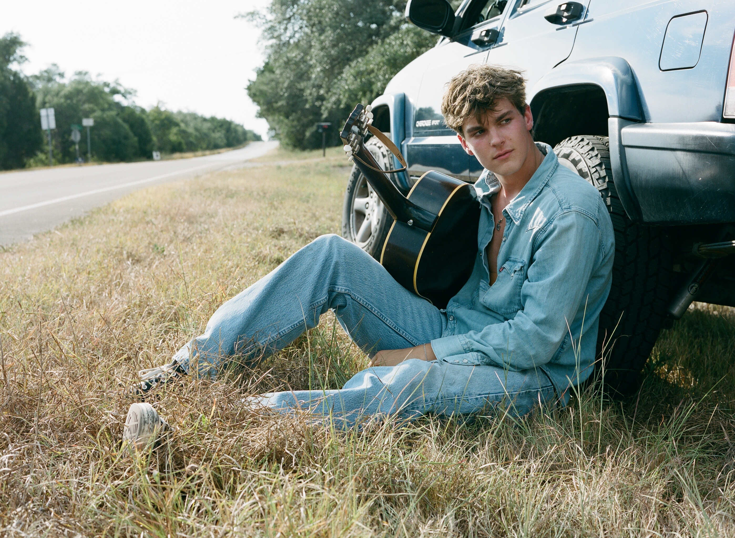
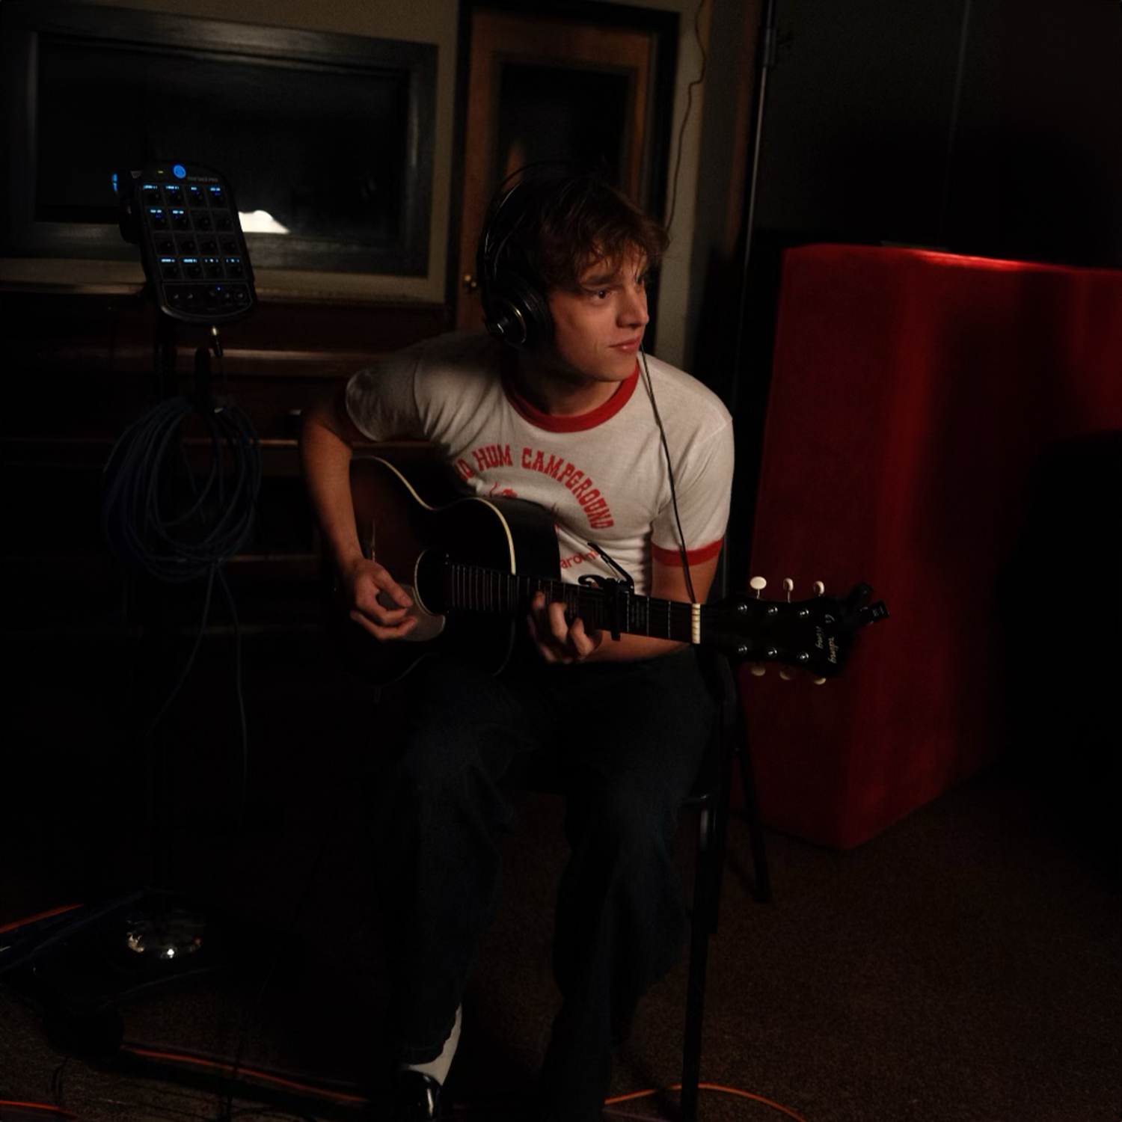
02 - OUR ARTISTS
OUR ARTISTS ARE THE STORY
All My Friends Inc. is a bootstrapped venture built on the conviction that real, lasting artist development isn't a temporary highway to a destination—it's an evolving journey that grows alongside the artist.

Slide 4
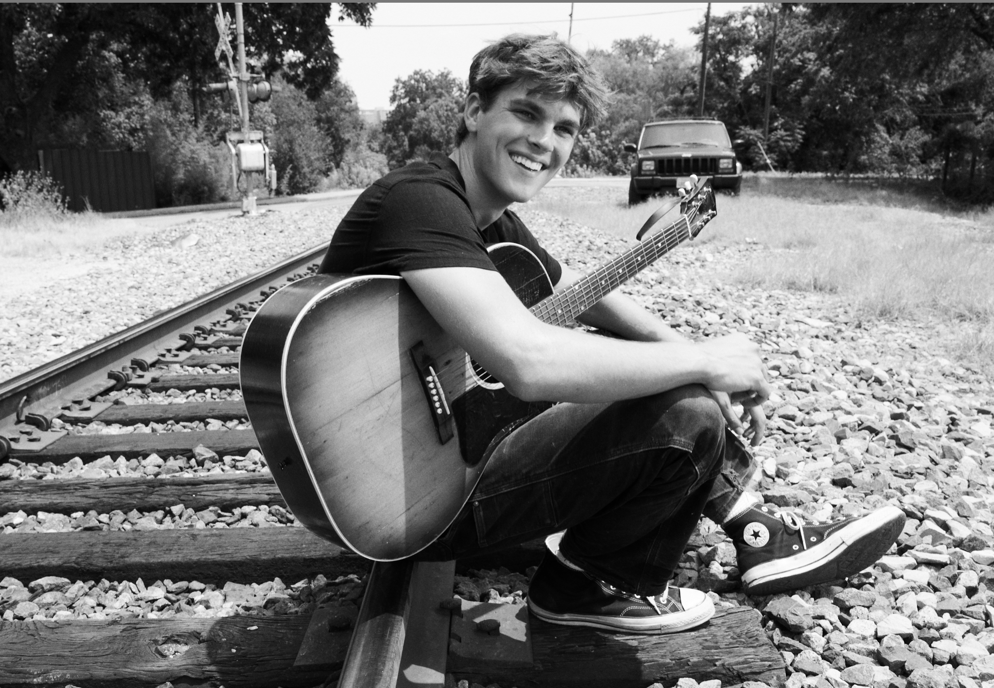
02 - ARTIST CASE STUDY
"Ingram’s sparkling tenor tone appears to be fully developed… it was lightning in a bottle."
Euphoria Magazine
HUDSON
INGRAM
AGE: 19 YEARS OLD
GENRE: POP, SINGER-SONGWRITER
HOMETOWN: AUSTIN, TEXAS
With heavyweight backing from Interscope, Universal Music Publishing, and the architects behind Taylor Swift, Gracie Abrams, Role Model, Bruno Mars, and Pink, Hudson is positioned to define the next era of male pop.
The All-American Boy-Next-Door, Nashville-based artist from Texas makes music that feels as big as commercial pop but is built on a foundation of sharp songwriting and real musicianship. The son of country artist Jack Ingram, he grew up immersed in storytelling, developing a style that merges intimate, deeply felt lyrics with hooks that hit on first listen. Obsessed with the craft, self-taught in production, and relentless in his pursuit of mastery, Hudson is carving his own lane—one that feels classic, yet completely his own.
RECORD LABEL: INTERSCOPE
FIRST EVER JOINT VENTURE SIGNING WITH PROLIFIC PRODUCER AARON DESSNER
PUBLISHING CO: UNIVERSAL MUSIC PUBLISHING GROUP
FIRST EVER SIGNING WITH PROLIFIC SONGWRITERS LIZ ROSE (TAYLOR SWIFT, LITTLE BIG TOWN) & KARA DIOGUARDI (MAROON 5, P!NK, CELINE DION, KELLY CLARKSON, BRUNO MARS, EMINEM, BRITNEY SPEARS)

Slide 5
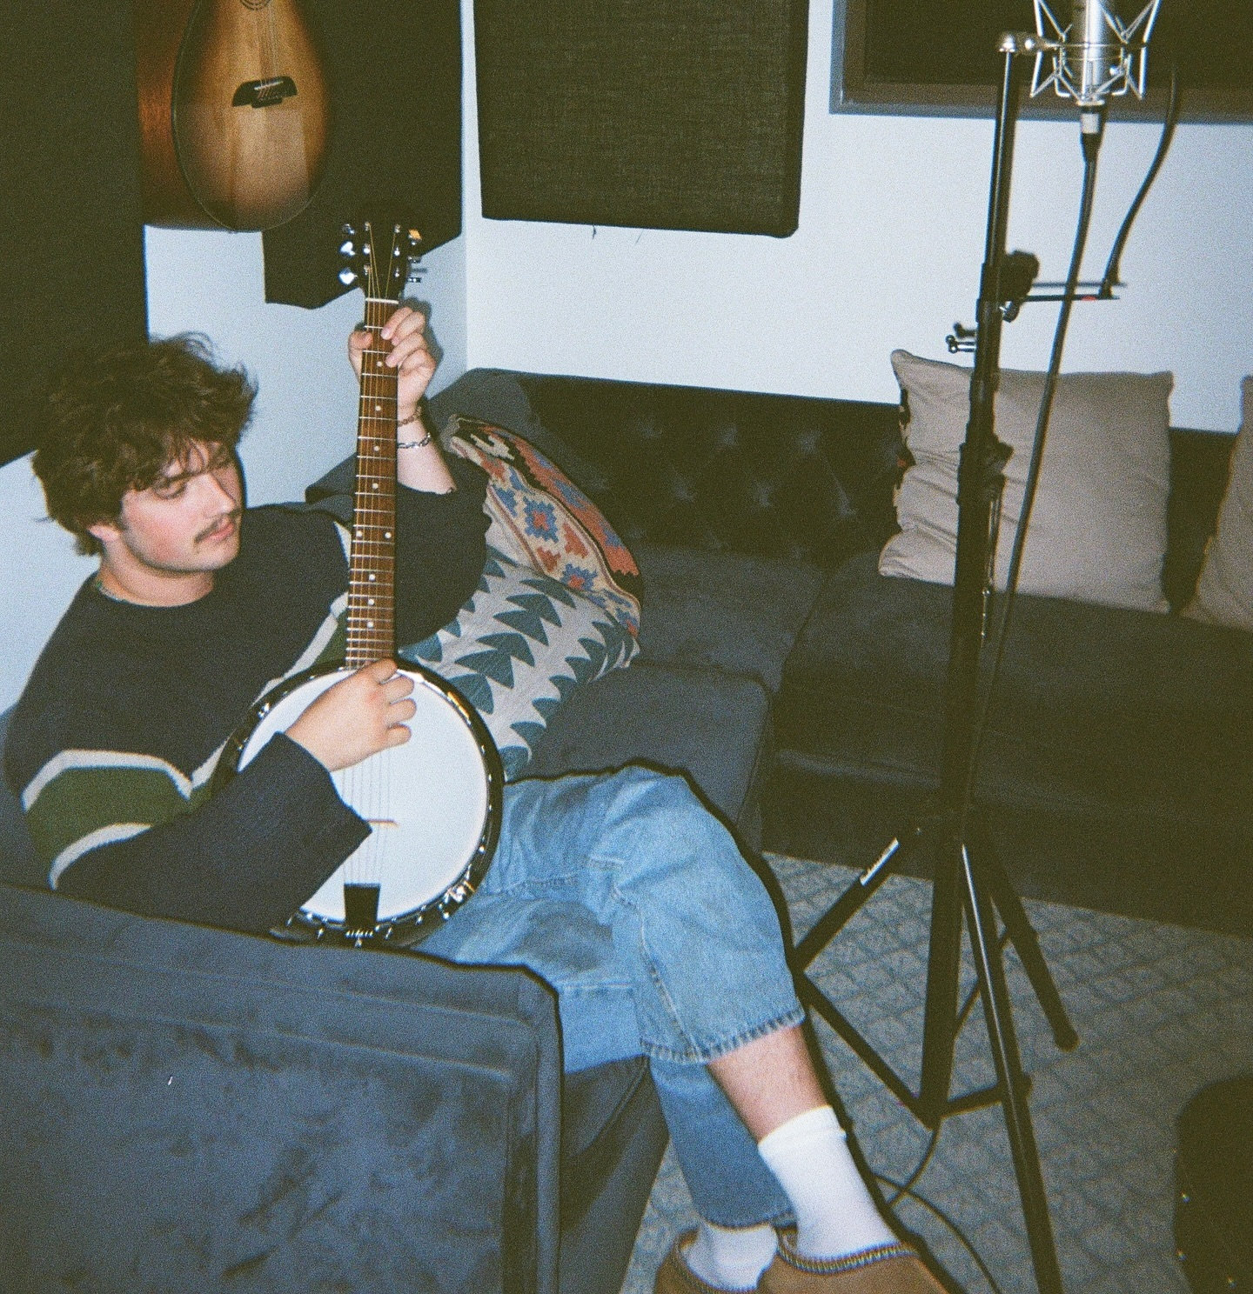
02 - PRODUCER CASE STUDY
JACK
SCHREPFERMAN
GENRE: POP, FOLK, COUNTRY, ROCK
HOMETOWN: INDIANAPOLIS, IN
AGE: 22
With heavyweight backing from Kobalt and 100 Publishing, and the creative teams behind Cirkut, Alex Da Kid, Stargate, Dijon, Bon Iver, Childish Gambino, and FKA twigs, Jack is positioned as one of the most versatile and commercially potent young producers in music.
THE ARCHITECT OF SOUND — Likened to Jack Antonoff and Dan Nigro for his ability to blend left-of-center artistry with chart-ready pop, Jack moves effortlessly between genres, from folk and country to cutting-edge alt-pop. At just 21, he has already proven his instinct for pairing sharp, boundary-pushing production with undeniable commercial appeal. With a major publishing deal anchoring his future, Jack’s unique combination of taste and hitmaking ability positions him as one of the defining creative forces of his generation.
COMPS:
Jack Antonoff,
Dan Nigro,
Gabe Simon,
Noah Conrad,
Cirkut
PUBLISHING: KOBALT / 100 PUBLISHING
Signed at 21, joining a roster that includes Cirkut, Alex Da Kid, Stargate, Dijon, Bon Iver, Childish Gambino, and FKA twigs.

Slide 6
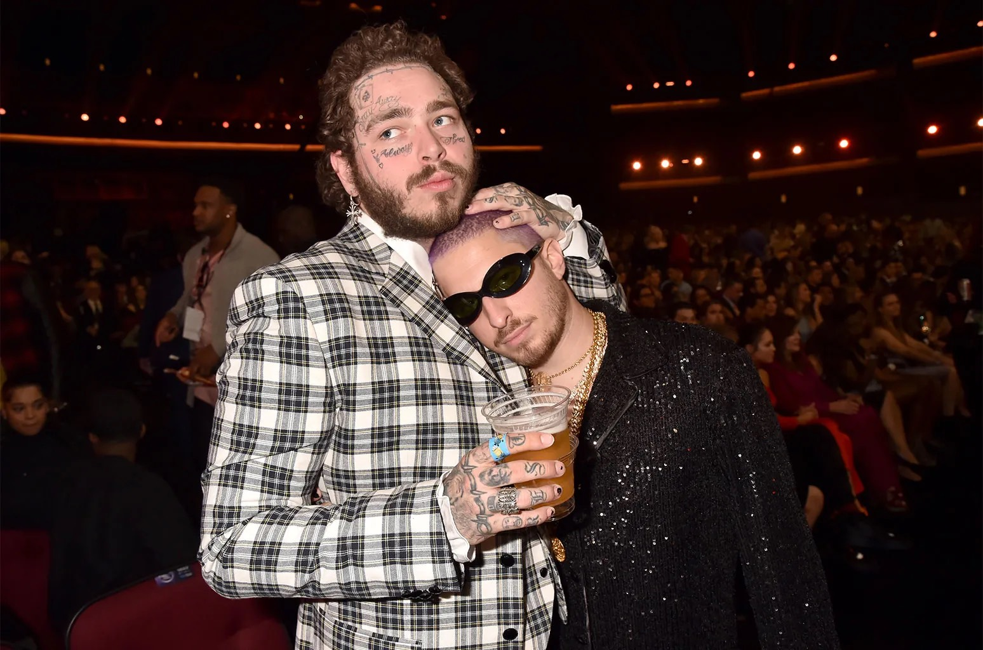
02 - ROSTER SYNERGY LIFT + ECOSYSTEM DESIGN
Cross-Roster Compounding
Our roster operates as a creative multiplier. When artists collaborate internally, they share audiences, reduce costs, and create a self-reinforcing cycle of growth. Every connection strengthens the whole—turning individual success into collective momentum.
AMF
Consolidated Value Capture Exponential Growth
2×
Illustrative Revenue Multiplier
Roster Synergy
2× Base
3×
Bigger Credits & Collaborations
3× Revenue
4×
Industry Attention & Validation
4× Revenue
5×
Halo Effect
5× Revenue
Bigger Signings → AMF Growth
6× Revenue
6×
SYNERGY CASE STUDY
Jack + Hudson
Individually, they already create value. Together, their synergy and output value compounds into exponential upside captured by AMF.
History Proves the Power of Artist–Producer Partnerships
Nearly every global superstar is built on a core artist–producer bond — partnerships that create not just hits, but cultural momentum, credibility, and a consistent identity that scales. We are structured and intend to capture both sides of that value: with Hudson × Jack as the model, we multiply returns across artist and producer lanes, creating a halo effect that compounds across the entire roster.
Illustrative Future Annual Value (Commission $M)
Hudson
(Individually)
Jack
(Individually)
Jack x Hudson
Multiplier Effect

Slide 7
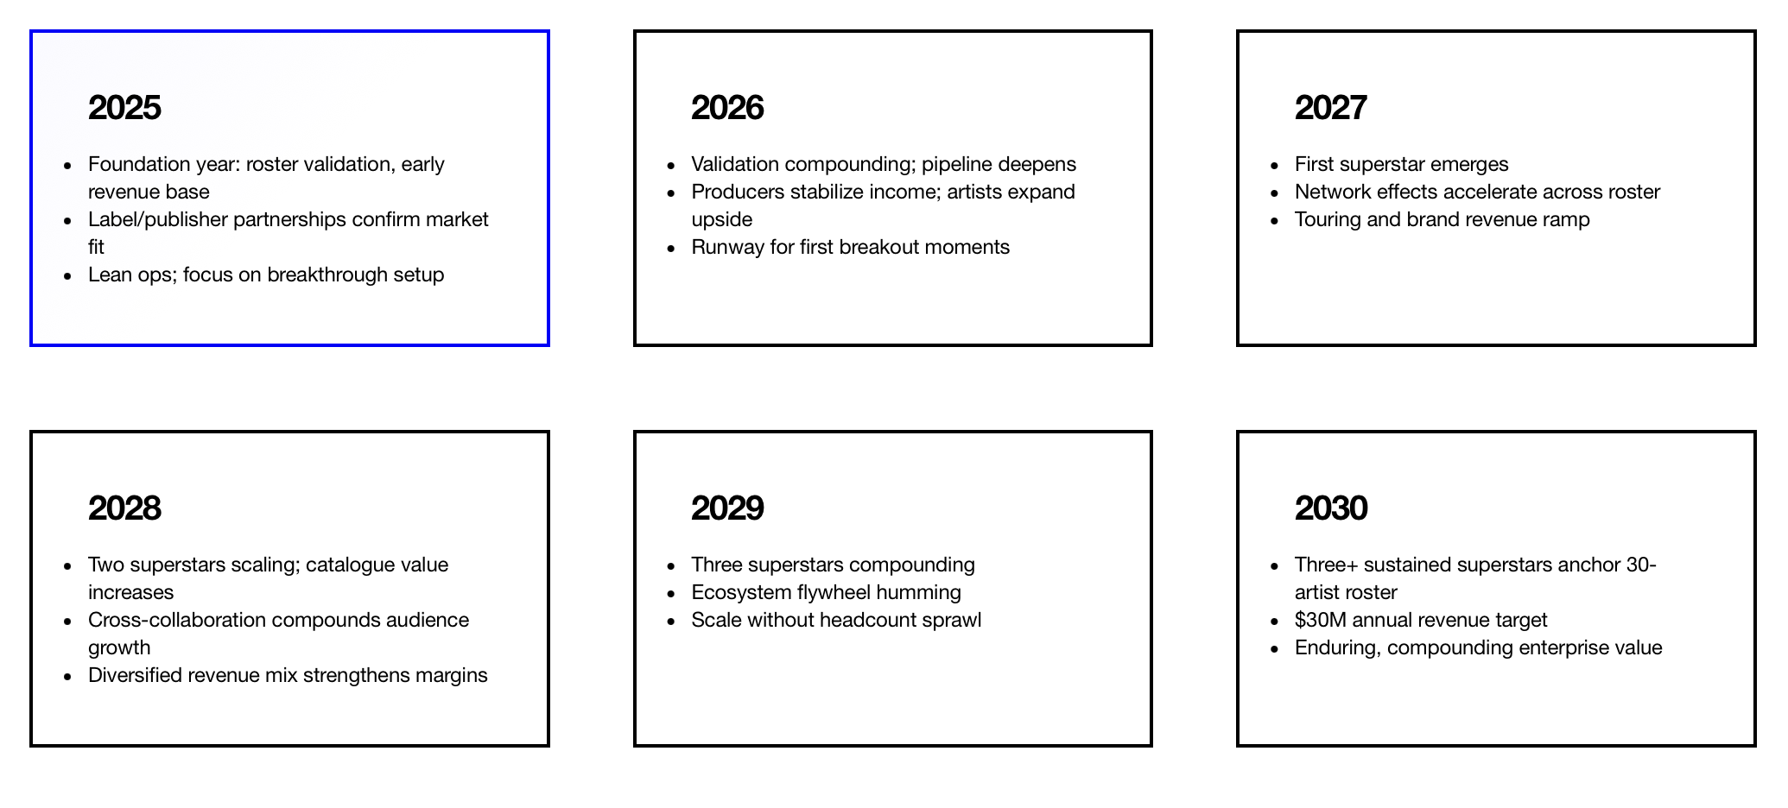
07 - THE VISION
THE ROAD TO $30M
Scale roster methodically to 30 artists/producers.
Cultivate at least 3 superstars in the next 5 years.
Diversify across genres and formats to increase stability.
Build a portfolio where each artist’s success multiplies opportunities for the others.
30 ARTISTS
$30M
BY 2030
Over the next five years, AMF will scale from a boutique roster into a diversified management ecosystem of 30 artists and producers by 2030. The model is simple:
One superstar changes everything. Even if just one artist breaks at scale, the business explodes — but we are not betting on one.
Diversification is our advantage. By balancing artists with producers, we smooth the natural ebbs and flows of careers while increasing hit probability.
The compounding flywheel. Every signing strengthens the others: producers amplify artists, artists pull producers into new rooms, and the company captures the exponential value at the center.
How Capital Will Be Used (High-Level): The $1M capital raise will be deployed to accelerate growth without diluting our strategic advantage:
Artist Development: Seeding projects, funding creative work, and supporting breakthrough campaigns that amplify label deal value by 5× (or, in unicorn cases, exponentially more).
Travel & Entertainment: Opening doors globally, maintaining high-touch relationships with labels, publishers, and brands.
Seed Funding for Artists: Providing upfront runway before label signings, ensuring leverage and outsized deal structures when labels enter the picture.
Strategic Infrastructure: Building the systems and relationships that allow AMF to scale to 30 artists while maintaining quality control.
Office & Creative Hub: Establishing a non-traditional loft-style space that functions as both headquarters and cultural hub — with workstations, a listening room, and open-plan areas that can double as showcase venue, meeting space, and creative studio.

Slide 8
THE PATH TO $30M ANNUAL REVENUE
2025
Foundation year: roster validation, early revenue base
Label/publisher partnerships confirm market fit
Lean ops; focus on breakthrough setup
2026
Validation compounding; pipeline deepens
Producers stabilize income; artists expand upside
Runway for first breakout moments
2027
First superstar emerges
Network effects accelerate across roster
Touring and brand revenue ramp
2028
Two superstars scaling; catalogue value increases
Cross-collaboration compounds audience growth
Diversified revenue mix strengthens margins
2029
Three superstars compounding
Ecosystem flywheel humming
Scale without headcount sprawl
2030
Three+ sustained superstars anchor 30-artist roster
$30M annual revenue target
Enduring, compounding enterprise value
Strategic Value of Investors
• A portion from music-aligned backers to make calls, connect dots, and pull strategic levers • Open to smart investors outside music who care about culture • Select advisory equity available for partners who syndicate or provide high-value advice
Use of Capital
• Signing and supporting future superstar artists • Expanding songwriter/producer infrastructure • Building touring, brand, and content platforms • Lean operations ensure capital fuels growth, not overhead
OUR CAPITAL STRUCTURE
Raising $1M in capital via SAFE at a $30M post-money valuation Simple, investor-aligned structure that protects founder ownership Anchored in a clear path to $30M annual revenue by 2030 This is the only raise — one opportunity to join before scale compounds
$1M
RAISE
$30M
POST-MONEY VALUATION
SAFE
STRUCTURE
Why This Structure Makes Sense
• Simple, investor-aligned structure that protects founder ownership • Anchored in a clear path to $30M annual revenue by 2030 • One opportunity to join before scale compounds
• Flexible, modern structure — no forced equity now • Aligns incentives for lean growth and breakout scale • Clean governance, clear upside
This is the only raise. Once complete, no further outside capital.
08 - THE INVESTMENT OPPORTUNITY
$1M
One opportunity to join before scale compounds.
Flexible, modern structure — no forced equity now.
Aligns incentives for lean growth and breakout scale.
Clean governance, clear upside.
CAP TABLE
$30M
VALUATION
SAFE
STRUCTURE

Slide 9
09 - THE FOUNDER
ABOUT THE FOUNDER
FOUNDER
THEO
BATTAGLIA
AGE: 32
HOMETOWN: LOS ANGELES, CA
PREVIOUSLY
10K PROJECTS (EXECUTIVE VICE PRESIDENT, CREATIVE)
APPLE INC (SERVICES MARKETING & CREATIVE)
HBO (CONTENT MARKETING)
WARNER BROS. (CREATIVE DEVELOPMENT & PRODUCTION)
EDUCATION
NYU | TISCH SCHOOL OF THE ARTS (GRADUATED 2014)

